Slide 1
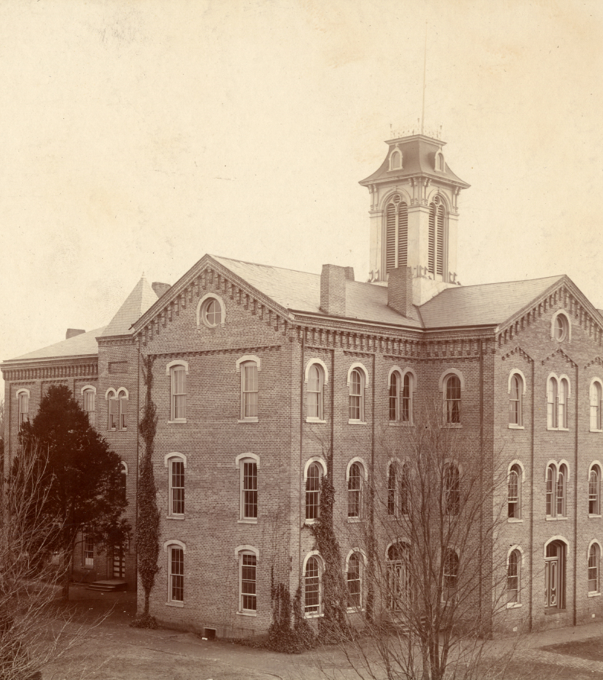
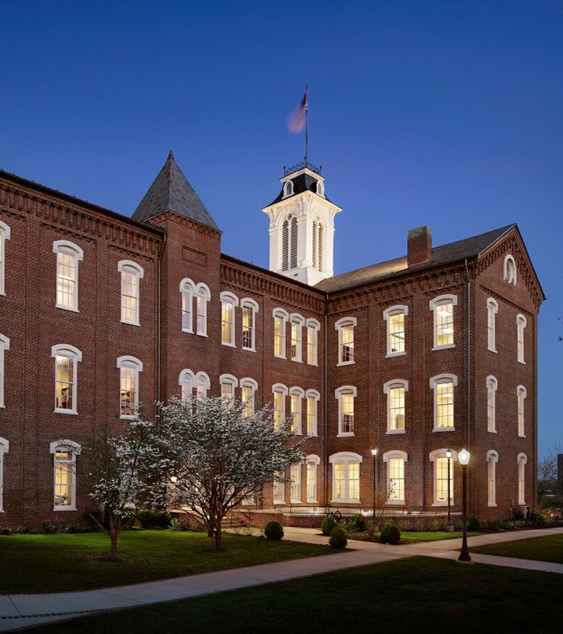
Anderson Hall-Maryville College Campus

Slide 2
Anderson Hall-Maryville College, constructed in 1869 and named for Maryville College’s first president, the Reverend Isaac Anderson, is the oldest building on campus.
Designed by Benjamin Fahnestock in the rare Second Empire style and built by contractor Alford McConnell known for the distinctive reddish-brown, hand-molded bricks he made for his buildings.
Anderson Hall along with residence halls Memorial and Baldwin was built as a new home for Maryville College (renamed from the Southern and Western Theological Seminary in 1842) after the original campus buildings in downtown Maryville were destroyed during the Civil War.
Funds for erecting the hall came from William Thaw of Pittsburgh, John C. Baldwin of New York and the U.S. Government through the Freedmen’s Bureau because of the College’s policy of “excluding none from its benefits by reason of race or color.”
In 1892, the “T wing” to the back of the building was completed; the design and the brick used for the addition were completely in keeping with the original structure. The “T wing” addition created a building with four wings forming a cross and crowned with a cupola bell tower.
The building was added to the National Register of Historic Places on February 20, 1975
Exterior renovations completed in 2008 and the first major interior renovation was completed in 2014.

Slide 3
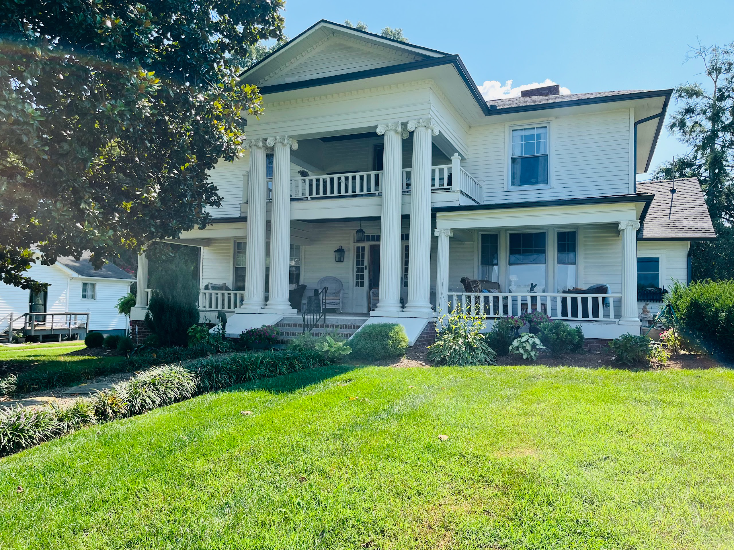
903 Court Street

Slide 4
903 Court Street, was constructed in 1910.
Known as the Samuel Dunn house, early occupants were attorney Samuel Dunn and is wife, Mary Alice Bird Dunn. Samuel was a successful attorney who was also interested in politics, the mercantile business, real estate and lumbering. Mary Alice was good friends with Eleanor Roosevelt who appointed her as postmistress general in Maryville. Mary Alice is buried in Grandview Cemetery.
This two-story frame, three bay, rectangular plan, Neo-Classical style residence has a brick foundation, hipped roof of composition shingles, interior and exterior brick chimneys, and metal siding.
On the main (E) facade is a two story gable roof portico with fluted wood columns and terra cotta Ionic capitals. At the eaves are dentils.
Behind the portico is a second story balcony with square balusters. The main facade also displays a one story porch with fluted wood columns, terra cotta Ionic capitals and a railing with square balusters.
The main entrance has a single light glass and frame door flanked by multi-light sidelights and topped with a multi-light transom.
At the rear is a c. 1920 frame, two stall, hipped roof garage.

Slide 5
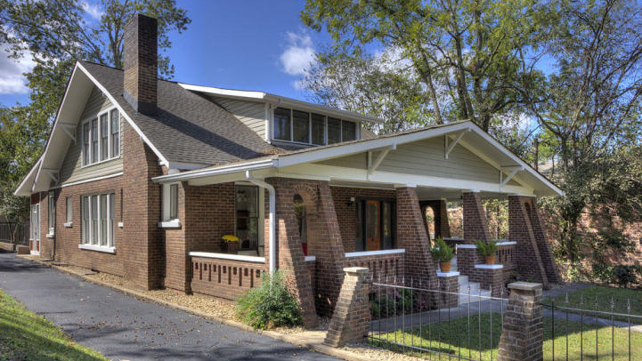
807 Court Street

Slide 6
807 COURT STREET was built in 1907. Legend has it that the original builder was playing baseball against Maryville College and hit a home run. He declared that he would build a house on the spot where the ball landed in what was then an orchard.
This brick Craftsman was ahead of its time, built a full 13+ years ahead of when the style became popular.
1961, the house was purchased by Walter and Nelle Barton who chose the location because they wanted their five children educated in Maryville schools. This is still a major draw for young families to Maryville today!
The home’s coal furnace was still working in the 60's, with the first window well on the driveway side (closest to the chimney) being the coal chute. here is still a little bit of coal in the basement and you can still see the worn brick at the top of the sill, from the inside
The Bartons occupied the house until the late 1970’s.
In February of 2022 the Barton siblings visited the house and recreated an old family Christmas photo!
In 2017, the house was updated. The butler pantry openings from the kitchen and dining room were opened up as the slender doors, now the closet doors in the first floor bedroom, were the doors into the butlers pantry.
At some point soon after building, the back porch was enclosed with 7 windows and 2 doors, as the windows are wavy and you can still see (from the back porch) the original wood flooring for the enclosed back porch. Underneath the back deck, the original steps from the back door and a small concrete pad are under the decking.
The brick and iron fence in the front was added sometime after the Barton family moved.

Slide 7
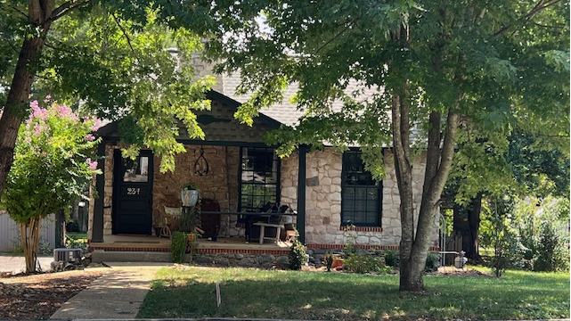
234 Wilson Avenue

Slide 8
234 Wilson Avenue, a stone cottage crafted of stone from a local marble quarry, was constructed in1928.
The home’s earliest occupants included William and Minnie Riley who owned Blount Laundry and Dry Cleaning.
Later the home was occupied by Reverend Howard Welsh, his wife Oceola Welsh and their 3 children. All five family members were Maryville College alumni and in1951 Maryville College bestowed an honorary Doctorate of Divinity on Reverend Welsh.

Slide 9
919 Court Street
Visit this historic home at anytime along the tour for a sweet treat and beverage!

